Slide 1


Usman Farooq Bajwa
19 September 2024

Slide 2

Outline
Executive Summary
Introduction
Methodology
Results
Conclusion
Appendix

Slide 3
Executive Summary
We are prediction the outcomes of the landing of Space X Falcon 9.
Summary of methodologies:
Data is gathered by using API and web scrapping. Cleaned the data. Analyzed the data by using Folium, Plotly dash and SQL. Do the feature analysis, which is better to create the model. Then Scaled the data. Machine Learning Classification model Logistic Regression, Support Vector Machine, Decision Tree and K Nearest Neighbors are created. GridSearchSV is used on train data to find the best parameter of each model. Then use the same model on test data to validate the model.
Summary of all results
Logistic Regression best parameters are 'C': 0.1, 'penalty': 'l2', 'solver': 'lbfgs'. The accuracy score on train data is 0.846429 and on test data is .8333.
Support Vector Machine best parameters are 'C': 1.0, 'gamma': 0.03162277660168379, 'kernel': 'sigmoid'. The accuracy score on train data is 0.848214 and on test data is 0.8333.
Decision Tree best parameters are 'criterion': 'gini', 'max_depth': 2, 'max_features': 'sqrt', 'min_samples_leaf': 2, 'min_samples_split': 2, 'splitter': 'best'. The accuracy score on train data is 0.875 and on test data is .7222.
K Nearest Neighbors classification algorithm best parameters are 'algorithm': 'auto', 'n_neighbors': 10, 'p': 1. The accuracy score on train data is 0.848214 and on test data is 0.8333.

Slide 4
Introduction
Project background and context
There is competition between space companies to get the tender and reduce cost of rocket launch.
Space X built such a rocket model which can be reused after the first launch and reduce the cost of launch.
There are multiple stages of Falcon 9 rocket. The first stage is costly. It is built to land successfully to be reused.
Problems you want to find answers
There is competition for spaceship launch. Companies want to launch satellite with lower price. This can be only possible if we reuse the spaceship again for the next trip. So, the problem is we want to know that the rocket will land successfully. For this several model of Machine learning are built to predict the outcome.

Slide 5

Section 1

Slide 6
Methodology
Executive Summary
Data collection methodology:
We used SpaceX API to collect the data.
Used the GET request to fetch and parse the data.
IDs are available for rocket, payloads, launchpad, and cores in the fetched data. SpaceX API used again to get the data against these IDs.
Kept only those data columns which are required.
Filter the data Falcon 9 launch only.
We also used the web scrapping to collect the Falcon 9 and Falcon Heavy launched record from the Wikipedia.

Slide 7
Methodology
Executive Summary
Perform data wrangling
Identify and calculate the percentage of the missing values.
Replace the missing values in ‘PayloadMass’ with the mean value.
Check the data type of each attribute.
Calculate the number of launched on each site
Create a new attribute ‘Class’. It is value 1 and 0. The value 1 represent the successful outcome of the landing and value 0 represent the unsuccessful outcome of the landing.
Check the count of values of attribute ‘Class’ to see that we have enough number of label data to train it.

Slide 8
Methodology
Executive Summary
Perform exploratory data analysis (EDA) using visualization and SQL
Perform interactive visual analytics using Folium and Plotly Dash
Perform predictive analysis using classification models
Created Numpy array ‘Y’ from the data column ‘Class’.
Standard all the data processed data using the ‘StandardScaler’ and transform it.
Use the ‘train_test_split’ function to split the between test data and train data.
Created Logistic Regression, Support Vector Machine, Decision Tree and K Nearest Neighbors object and then created CridSearchCV object for each machine Logistic Regression, Support Vector Machine, Decision Tree and K Nearest Neighbors objects. The fitted the each CridSearchCV models with the test data to find the best parameter for the model.

Slide 9
Methodology
Executive Summary
Used the trained models on test data and find the result.
Created confusion matrix of each test data to know the result and do the analysis between models.

Slide 10
Data Collection
Get the request response from the SpaceX API.
Decode the response content by using .json() function and create a dataframe from the decoded response by using the pd.json_normalize().
The columns rocket, payloads, launchpad, and cores has identification number. SpaceX API will be used again to get the information against these identification number of these columns.

Slide 11
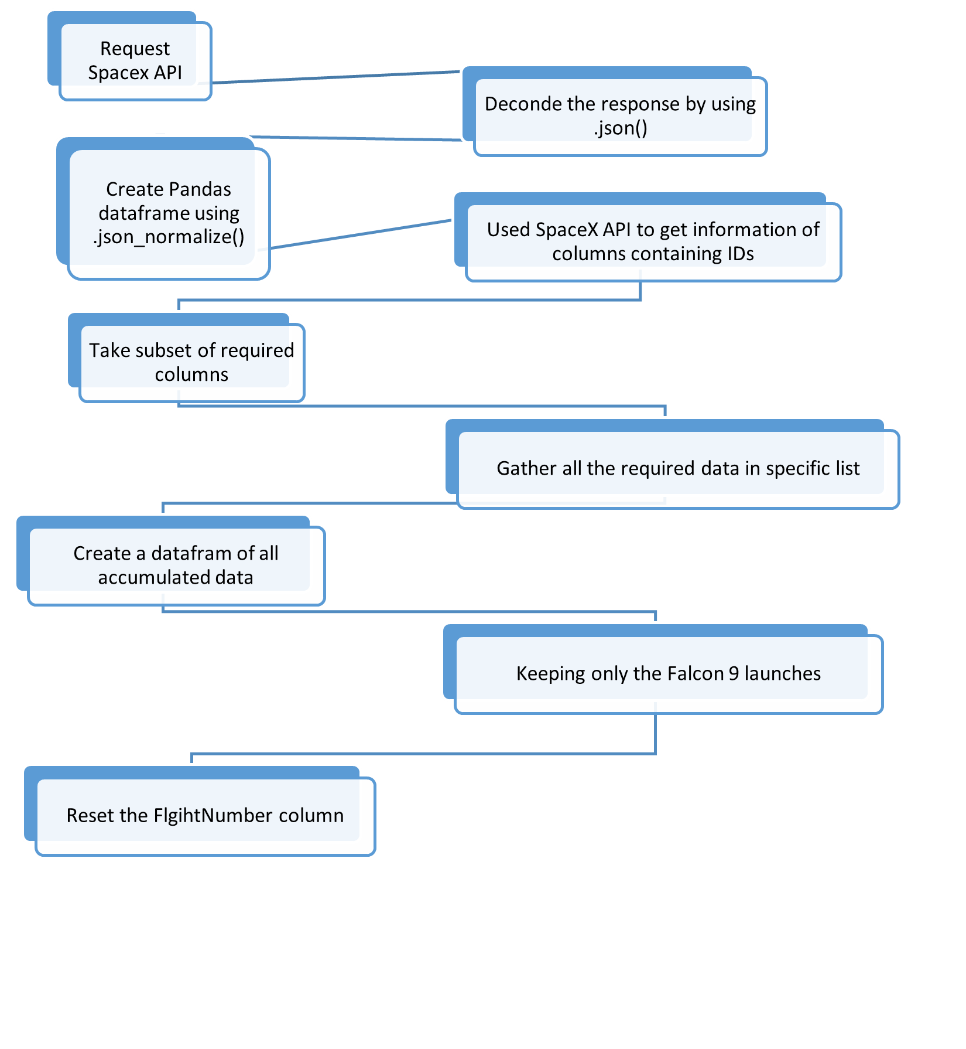
Data Collection – SpaceX API
Request Spacex API
Deconde the response by using .json()
Create Pandas dataframe using .json_normalize()
Used SpaceX API to get information of columns containing IDs
Take subset of required columns
Gather all the required data in specific list
Create a datafram of all accumulated data
Keeping only the Falcon 9 launches
Reset the FlgihtNumber column
https://github.com/UsmanFarooqBajwa/WinningSpaceRaceWithDataScience/blob/main/5%20-%20jupyter-labs-spacex-data-collection-api.ipynb

Slide 12
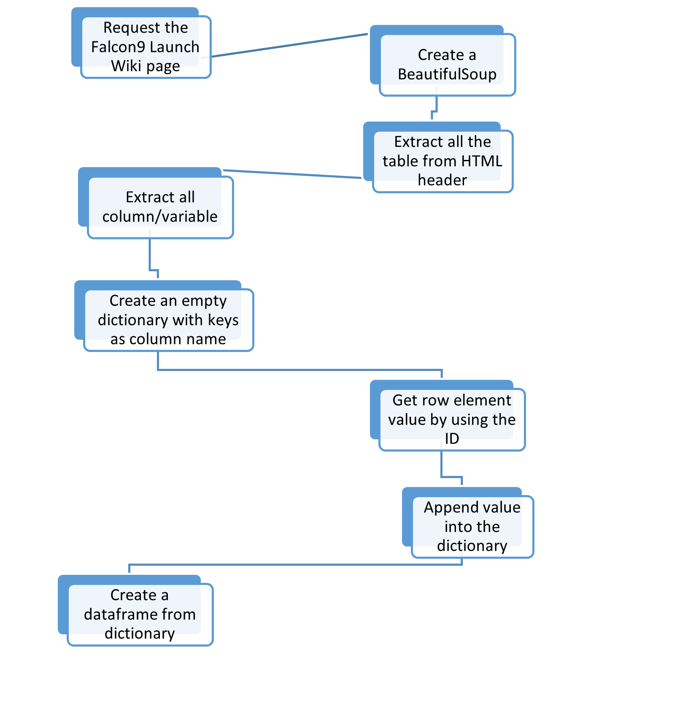
Data Collection - Scraping
Request the Falcon9 Launch Wiki page from its URL
Create a BeautifulSoup object from the HTML response
Extract all the table from HTML header (beSoup.find_all('table'))
Extract all column/variable names from the HTML table header (first_launch_table.find_all('th'))
Create an empty dictionary with keys from the extracted column names
Get row element value by using the ID
Append value into the dictionary (For specific attribute list)
Create a dataframe from the parsed launch record values which are filled into launch dictionary
https://github.com/UsmanFarooqBajwa/WinningSpaceRaceWithDataScience/blob/main/6%20-%20jupyter-labs-webscraping.ipynb

Slide 13
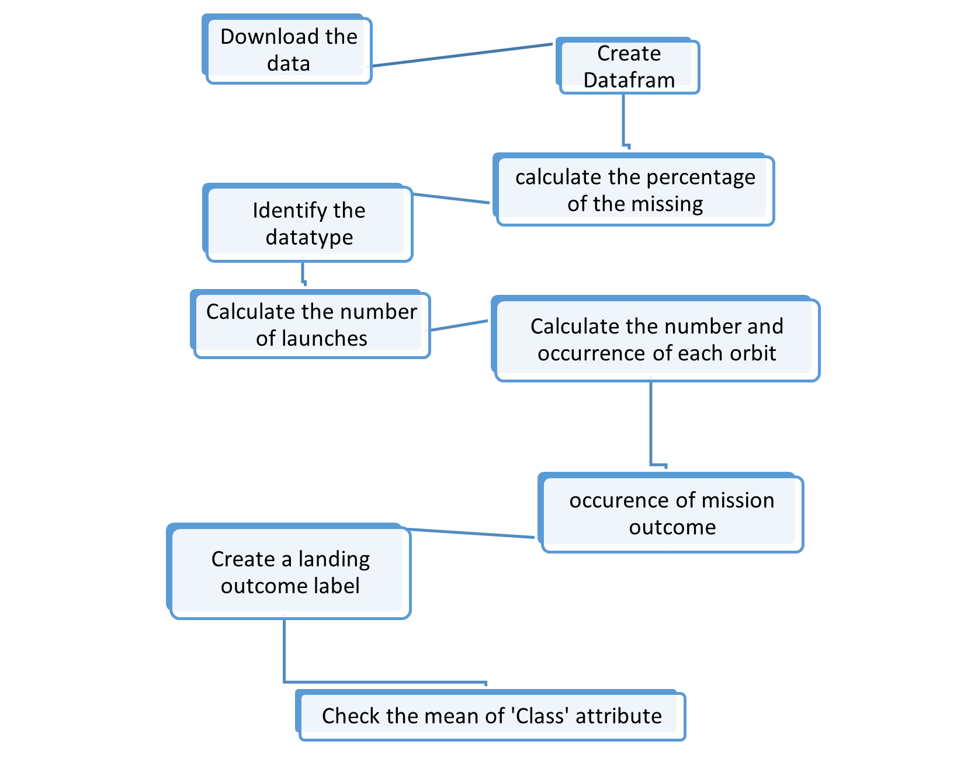
Data Wrangling
Create Datafram.
Identify and calculate the percentage of the missing values in each attribute. (df.isnull().sum()/len(df)*100)
Identify the datatype of each attribute. (df.dtypes)
Calculate the number of launches on each site. (df['LaunchSite'].value_counts())
Calculate the number and occurrence of each orbit. (df['Orbit'].value_counts())
Calculate the number and occurence of mission outcome of each orbits. (landing_outcomes = df['Outcome'].value_counts())
Create a landing outcome label from Outcome column and assign it to 'Class' attribute.
Check the mean of 'Class' attribute. (df["Class"].value_counts())
https://github.com/UsmanFarooqBajwa/WinningSpaceRaceWithDataScience/blob/main/8-%20labs-jupyter-spacex-Data%20wrangling.ipynb

Slide 14
EDA with Data Visualization
Plot FlightNumber vs. PayloadMassand along with overlay of the launch outcome is showing that heavey payload are less likely to land. And it also showing that as the flight number increases, the first stage is more likely to land successfully.
Visualize the relationship between Flight Number and Launch Site
Visualize the relationship between Payload and Launch Site
Visualize the relationship between success rate of each orbit type
Visualize the relationship between FlightNumber and Orbit type
Visualize the relationship between Payload and Orbit type
Visualize the launch success yearly trend
obtain some preliminary insights about how each important variable would affect the success rate
Use the function get_dummies and features dataframe to apply OneHotEncoder to the column Orbits, LaunchSite, LandingPad, and Serial.
https://github.com/UsmanFarooqBajwa/WinningSpaceRaceWithDataScience/blob/main/jupyter-labs-eda-dataviz.ipynb

Slide 15
EDA with SQL
Load the SQL extension and establish a connection with the database.
Remove blank rows from table.
Following queries are made into the database to know more about things inside data.
Check the names of the unique launch sites in the space mission.
Check the records where launch sites begin with the string 'CCA'.
know the total payload mass carried by boosters launched by NASA (CRS).
See what is the average payload mass carried by booster version F9 v1.1.
To know the date when the first succesful landing outcome in ground pad was acheived.
What are the names of the boosters which have success in drone ship and have payload mass greater than 4000 but less than 6000.
Check that the total number of successful and failure mission outcomes.
See the names of the booster_versions which have carried the maximum payload mass.
Check the records for the months in year 2015 what is the month names, landing_outcomes, booster versions, launch_site in drone ship.
See the order of the landing outcomes between the date 2010-06-04 and 2017-03-20.
https://github.com/UsmanFarooqBajwa/WinningSpaceRaceWithDataScience/blob/main/2%20-%20jupyter-labs-eda-sql-coursera_sqllite.ipynb

Slide 16
Build an Interactive Map with Folium
The circle object create a circle on the map for specific object. It is good to for view and analysis.
The marker object create a marker explaining the name / detail about the area.
The line object create line between two object to show distance or path.
The these objects are required to see the launch sites along with the name and circle on the map and distance between certain points.
It is good for geographical pattern analysis about launch sites.
https://github.com/UsmanFarooqBajwa/WinningSpaceRaceWithDataScience/blob/main/10_3_2%20-%20ab_jupyter_launch_site_location.ipynb

Slide 17
Build a Dashboard with Plotly Dash
Want to check the success rate of each site.
Want to check the percentage of higher success rate launch site.
Want to check the relationship between payload and booster version.
Want to check the higher payload are being used in which site.
https://github.com/UsmanFarooqBajwa/WinningSpaceRaceWithDataScience/blob/main/10_3_2%20spacex_dash_app.py

Slide 18
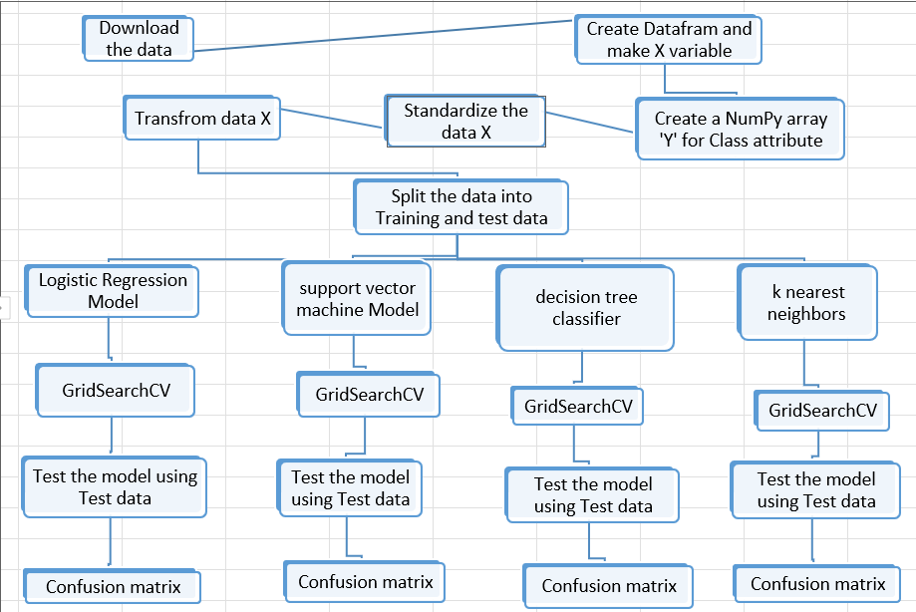
Predictive Analysis (Classification)

Slide 19
Predictive Analysis (Classification) (Cont…)
Download the data. Load it into Dataframe and save in as X varible.X = pd.read_csv(wget.download(URL2))
Create a NumPy array from the column Class in data, by applying the method to_numpy() then assign it to the variable Y.
Standardize the data in X. transform = preprocessing.StandardScaler()
Transform the data and save back to Variable X.
Split the data into training and testing data using the function train_test_split. X_train, X_test, Y_train, Y_test = train_test_split(X,Y,test_size=.2,random_state=2)
Create a Logistic regression model. lr=LogisticRegression()
Add logitic regression model along with the parameter inside GridSearchCV function to create object. logreg_cv = GridSearchCV(estimator=lr,param_grid=parameters,cv=10)
Then fit this GridSearchCV object on train dataset to find the best Hyperparameters. logreg_cv.fit(X_train,Y_train)
Calculate the accuracy on the test data using the method score. print("Test Accuracy score:",logreg_cv.score(X_test, Y_test))
Create a confusion matrix on test data result. plot_confusion_matrix(Y_test,yhat)
Add logitic regression model along with the parameter inside GridSearchCV function to create object. logreg_cv = GridSearchCV(estimator=lr,param_grid=parameters,cv=10)
Then fit this GridSearchCV object on train dataset to find the best Hyperparameters. logreg_cv.fit(X_train,Y_train)
Calculate the accuracy on the test data using the method score. print("Test Accuracy score: ",logreg _cv.score(X_test, Y_test))

Slide 20
Predictive Analysis (Classification) (Cont…)
Create a support vector machine model. svm = SVC()
Set the parameters. parameters = {'kernel':('linear', 'rbf','poly','rbf', 'sigmoid'),'C': np.logspace(-3, 3, 5),'gamma':np.logspace(-3, 3, 5)}
Add support vector machine model along with the parameter inside GridSearchCV function to create object. svm_cv = GridSearchCV(estimator=svm,param_grid=parameters,cv=10)
Then fit this GridSearchCV object on train dataset to find the best Hyperparameters. svm_cv.fit(X_train,Y_train)
Calculate the accuracy on the test data using the method score. print("tuned hpyerparameters :(best parameters) ",svm_cv.best_params_)
Create a confusion matrix on test data result. plot_confusion_matrix(Y_test,yhat)
Create a decision tree classifier model. tree = DecisionTreeClassifier()
Set the parameters. parameters = {'criterion': ['gini', 'entropy'],'splitter': ['best', 'random'],'max_depth': [2*n for n in range(1,10)],'max_features': ['auto', 'sqrt'], 'min_samples_leaf': [1, 2, 4],'min_samples_split': [2, 5, 10]}
Add decision tree classifier model along with the parameter inside GridSearchCV function to create object. tree_cv = GridSearchCV(estimator=tree,param_grid=parameters,cv=10)
Then fit this GridSearchCV object on train dataset to find the best Hyperparameters. tree_cv.fit(X_train,Y_train)
Calculate the accuracy on the test data using the method score. print("tuned hpyerparameters :(best parameters) ",tree_cv.best_params_)
Create a confusion matrix on test data result. plot_confusion_matrix(Y_test,yhat)
Create a k nearest neighbors model. KNN = KNeighborsClassifier()

Slide 21
Predictive Analysis (Classification) (Cont…)
Set the parameters. parameters = {'n_neighbors': [1, 2, 3, 4, 5, 6, 7, 8, 9, 10],'algorithm': ['auto', 'ball_tree', 'kd_tree', 'brute'],'p': [1,2]}
Add k nearest neighbors model along with the parameter inside GridSearchCV function to create object. knn_cv = GridSearchCV(estimator=KNN,param_grid=parameters,cv=10)
Then fit this GridSearchCV object on train dataset to find the best Hyperparameters. knn_cv.fit(X_train,Y_train)
Calculate the accuracy on the test data using the method score. print("tuned hpyerparameters :(best parameters) ",knn_cv.best_params_)
Create a confusion matrix on test data result. plot_confusion_matrix(Y_test,yhat)
Find the model who perform best on the test data.
https://github.com/UsmanFarooqBajwa/WinningSpaceRaceWithDataScience/blob/main/10_4_2%20-%20SpaceX_Machine_Learning_Prediction_Part_5.jupyterlite.ipynb

Slide 22
Results
Exploratory data analysis results
Flight Number vs. Launch Site scatter point plot is showing that at earliear flights, the landing success of first stage is low. While the flight increases the lading success also increases. The Landing success is increasing at launch site 'CCAFS SLC 40'as flight number increases. The launch site 'VAFB SLC 4E' has more landing success rate overall. More flights are happend at launch site 'CCAFS SLC 40'
Payload Vs. Launch Site scatter point chart also show that more Payload Mass (More than 10000) have higher successful rate of landing. Both sites 'CCAFS 40' and 'KSC LC 39A' are almost equally suitable for successfully landing for heavey Paylaod Mass. More launches are heppend in site 'CCAFS SLC 40' for payload Mass less than 8000.
After analysing the bar chart plot, the orbits 'ES-L1', 'GEO', 'HEO' and 'SSO' have high success rate.
In VLEO, MEO and SSO orbits, the success rate increases as the number of flights increases. While there is no relationship between ISS orbit and flight number. There is only one flight in HEO, SO AND GEO orbits.
However for GTO we cannot distinguish this well as both positive landing rate and negative landing(unsuccessful mission) are both there here.
On the other hand, on SSO orbit, light payloads landing rate are 100% successful. For HEO, SO and GEO orbit, there is only one launch toward these orbit so we cannot say about any relationship betweem these orbits and payloads.
On the other hand, success rate started declining after 2017 until 2018. Again from 2018, the success kept increasing till 2019 and then there is some decline in success rate after 2019 until 2020.

Slide 23
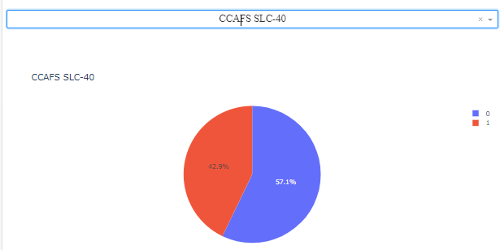
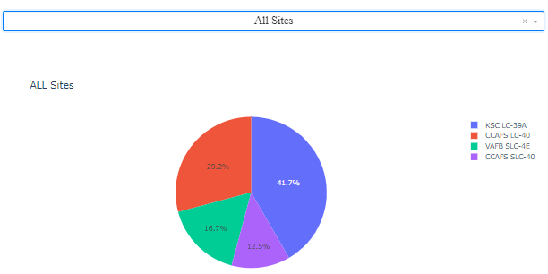
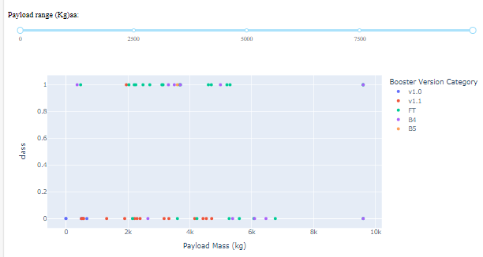
Results (Cont …)
Interactive analytics demo in screenshots:

Slide 24
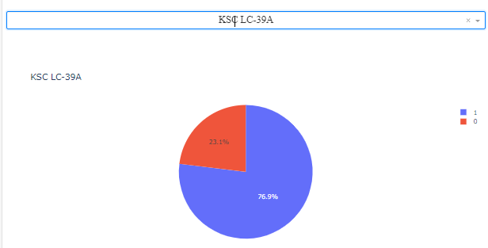
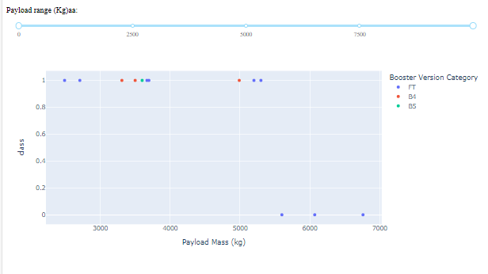
Results (Cont …)
Interactive analytics demo in screenshots:

Slide 25
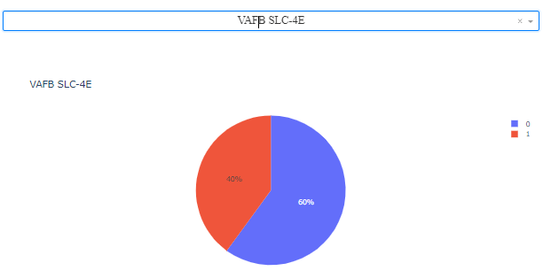
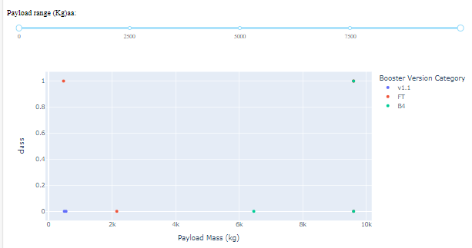
Results (Cont …)
Interactive analytics demo in screenshots:

Slide 26
Results (Cont …)
Predictive analysis results
On Train data Decision Tree Classifier has highest accuracy score 0.875.
On Test data set Logistic Regression, Support vector machine and K-Neighbors Classifier models have equal higher accuracy score 0.8333.
On Test data Decision Tree Classifier has lowest accuracy score 0.7222.
Logistic Regression, Support vector machine and K-Neighbors Classifier have same confusion matrix.

Slide 27

Section 2

Slide 28
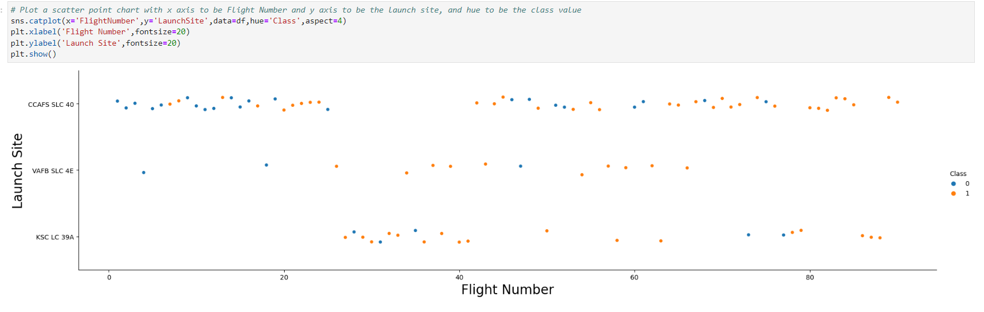
Flight Number vs. Launch Site
Show the screenshot of the scatter plot with explanations

Slide 29
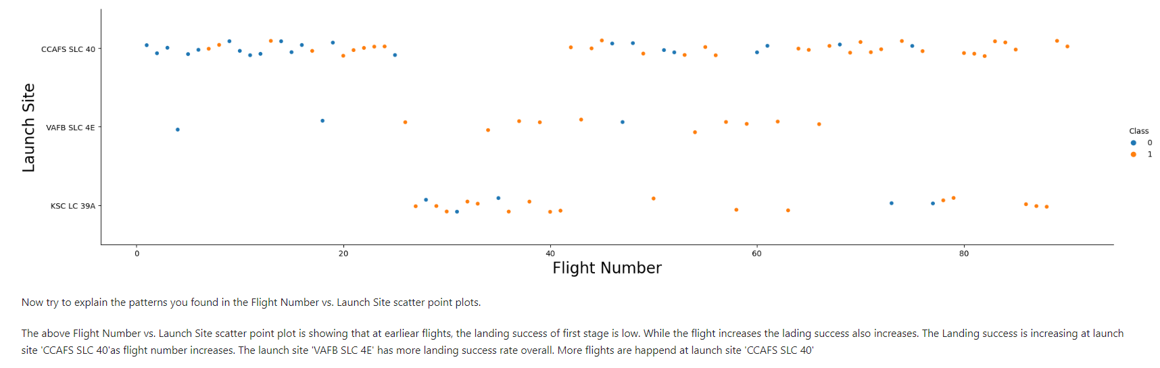
Flight Number vs. Launch Site (Cont…)

Slide 30
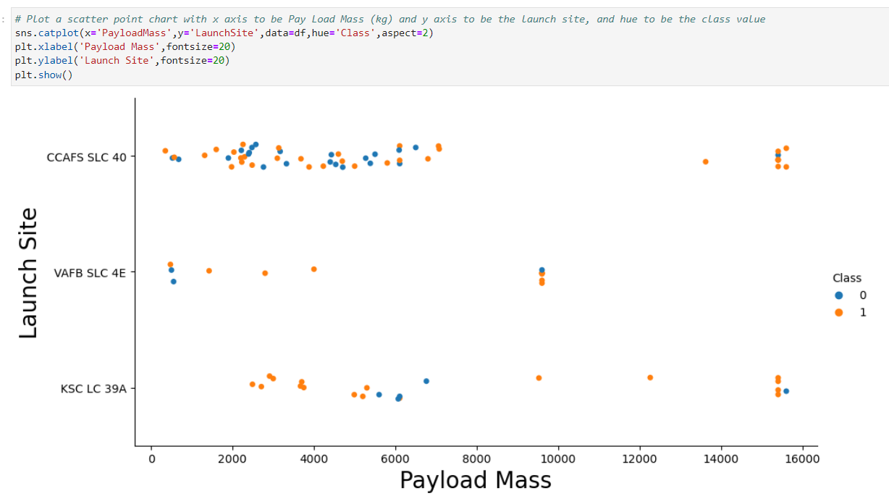
Payload vs. Launch Site
Show a scatter plot of Payload vs. Launch Site
Show the screenshot of the scatter plot with explanations

Slide 31
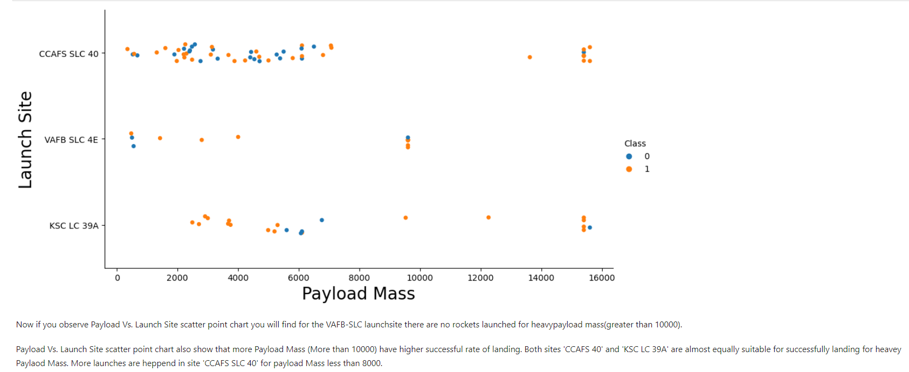
Payload vs. Launch Site (Cont…)
Show a scatter plot of Payload vs. Launch Site
Show the screenshot of the scatter plot with explanations

Slide 32
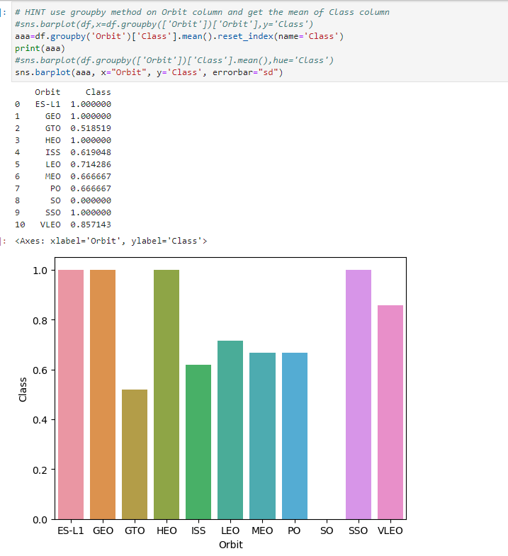
Success Rate vs. Orbit Type
Show a bar chart for the success rate of each orbit type
Show the screenshot of the scatter plot with explanations

Slide 33
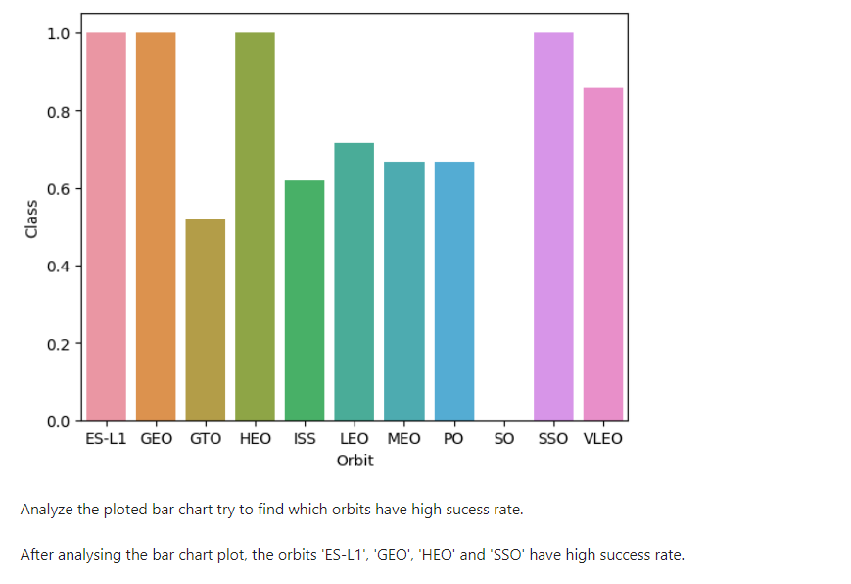
Success Rate vs. Orbit Type (Cont…)
Show a bar chart for the success rate of each orbit type
Show the screenshot of the scatter plot with explanations

Slide 34
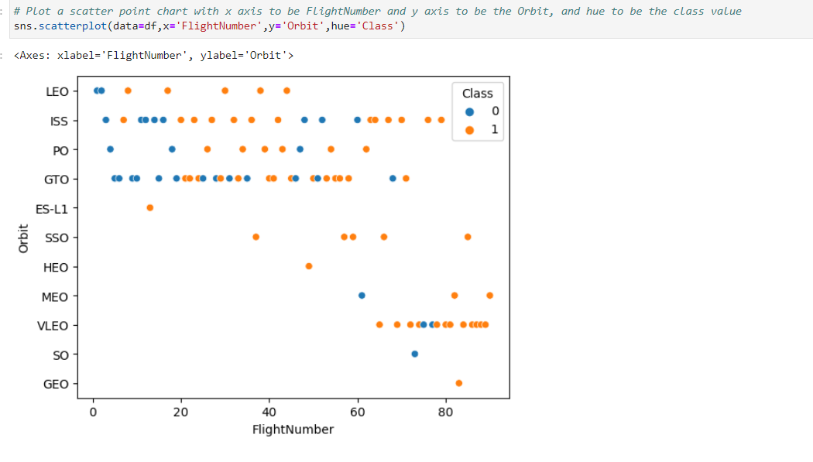
Flight Number vs. Orbit Type
Show a scatter point of Flight number vs. Orbit type
Show the screenshot of the scatter plot with explanations

Slide 35
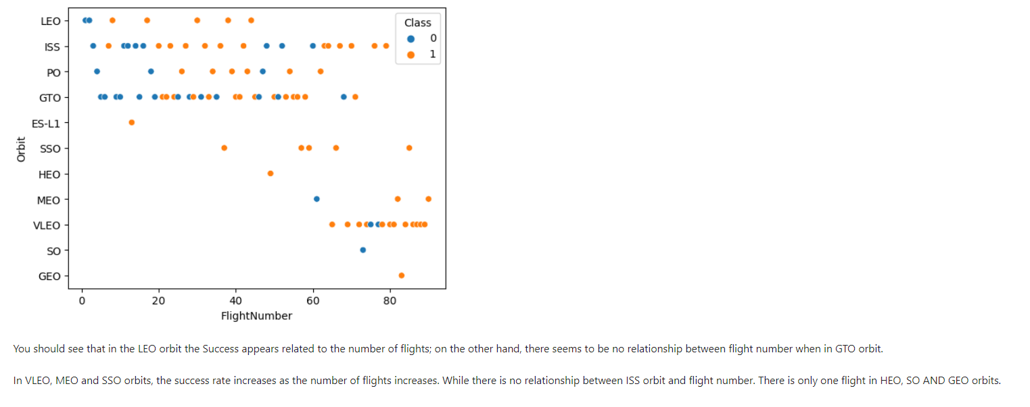
Flight Number vs. Orbit Type (Cont…)
Show a scatter point of Flight number vs. Orbit type
Show the screenshot of the scatter plot with explanations

Slide 36
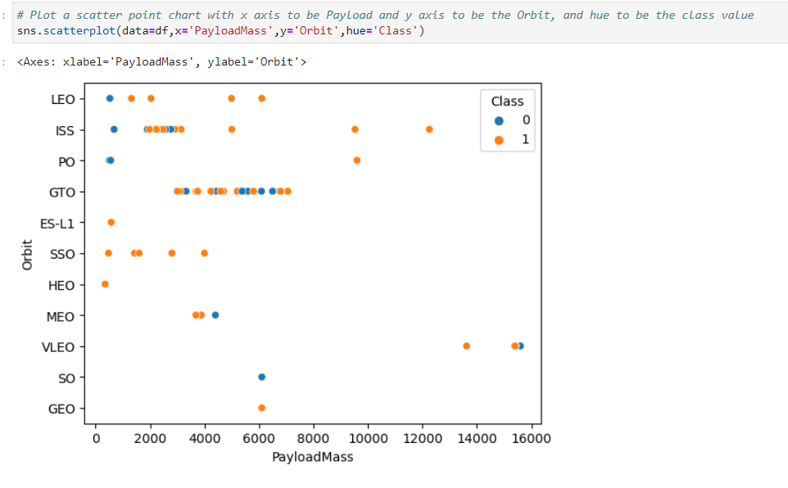
Payload vs. Orbit Type
Show a scatter point of payload vs. orbit type
Show the screenshot of the scatter plot with explanations

Slide 37
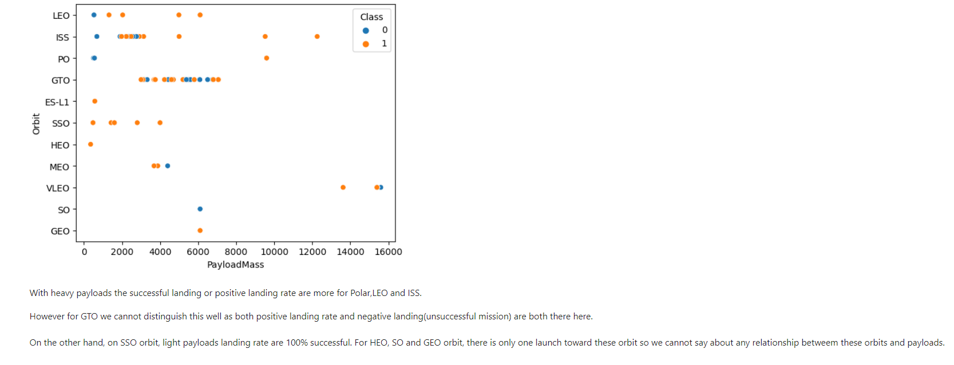
Payload vs. Orbit Type (Cont…)
Show a scatter point of payload vs. orbit type
Show the screenshot of the scatter plot with explanations

Slide 38
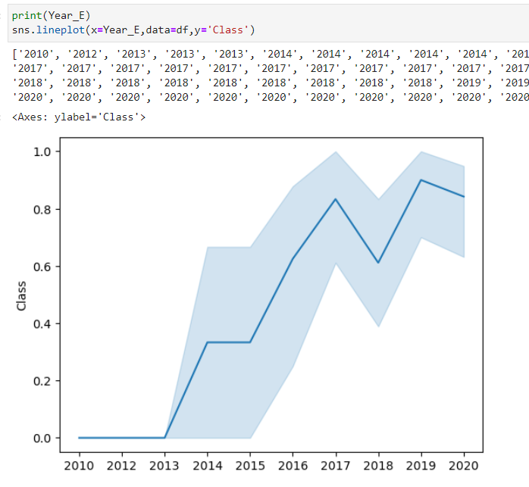
Launch Success Yearly Trend
Show a line chart of yearly average success rate
Show the screenshot of the scatter plot with explanations

Slide 39
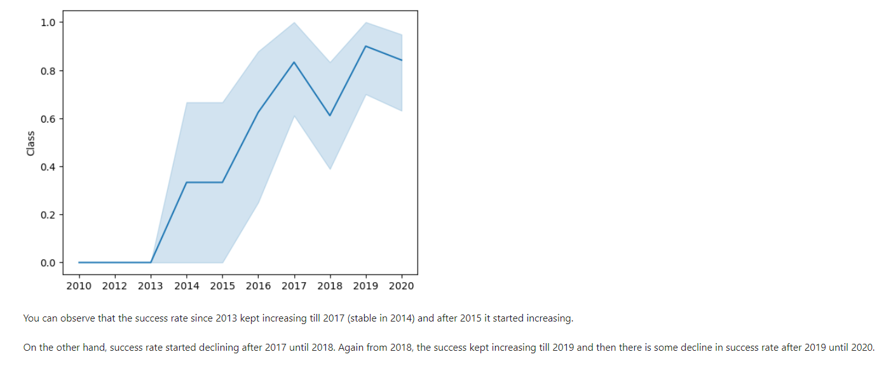
Launch Success Yearly Trend (Cont…)
Show a line chart of yearly average success rate
Show the screenshot of the scatter plot with explanations

Slide 40
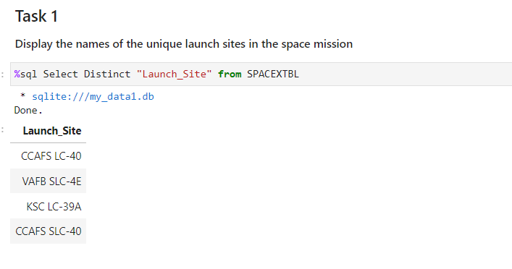
All Launch Site Names
Below is the result of the query to find unique launch sites from the database in Launch_Site column by using the Distinct key word.

Slide 41
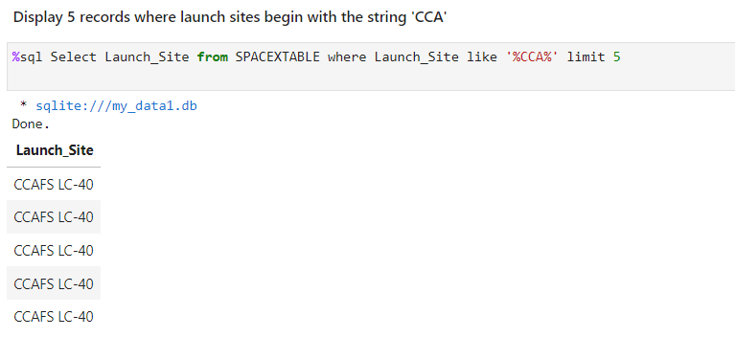
Launch Site Names Begin with 'CCA'
Below is the result of the query to find 5 records where launch sites begin with `CCA`. Finding matching string ‘CCA’ from the database in Launch_Site column and limit the result to 5.

Slide 42
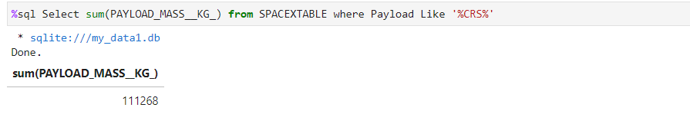
Total Payload Mass
Below is the result of the query to find total payload carried by boosters from NASA by finding matching string ‘CRS’ from the database in Payload column and sum the selected rows of column PAYLOAD_MASS_KG.

Slide 43
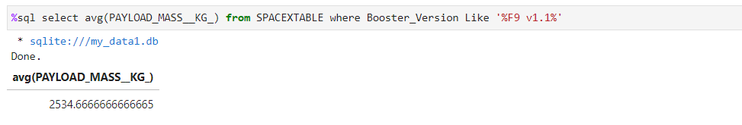
Average Payload Mass by F9 v1.1
Below is the result of the query to find the average payload mass carried by booster version F9 v1.1 by finding matching string ‘F9 v1.1 ’ from the database in Booster_Version column and average the mass values of resulted rows of column PAYLOAD_MASS_KG.

Slide 44
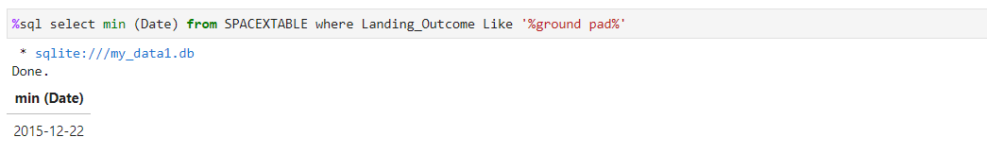
First Successful Ground Landing Date
Below is the result of the query to find the dates of the first successful landing outcome on ground pad by finding matching string ‘ground pad’ from the database in ‘Landing_Outcome’ column and use the min function on the resulted rows of column Date.

Slide 45
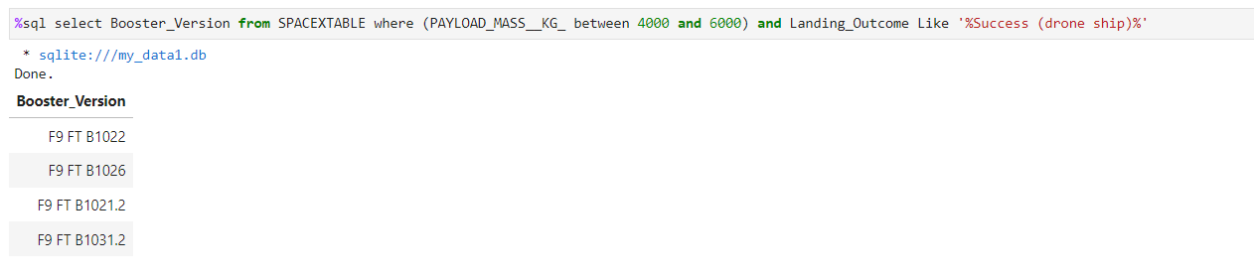
Successful Drone Ship Landing with Payload between 4000 and 6000
Below is the result of the query to find List the names of boosters which have successfully landed on drone ship and had payload mass greater than 4000 but less than 6000 by finding matching string ‘Success (drone ship)’ from the database in ‘Landing_Outcome’ column and getting the ‘PAYLOAD_MASS__KG_’ range between 4000 and 6000 and use column ‘Booster_Version ‘ to show the results.

Slide 46
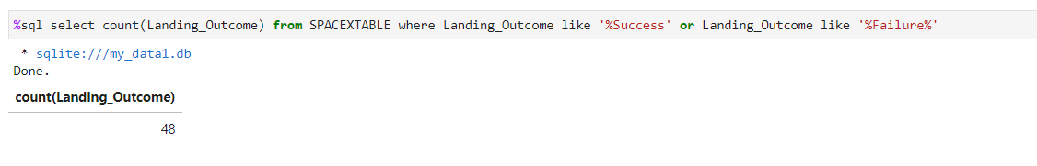
Total Number of Successful and Failure Mission Outcomes
Below is the result of the query to find total number of successful and failure mission outcomes by finding matching string ‘failure‘ OR ‘success‘ from the database in ‘Landing_Outcome’ column and use count function on column ‘Landing_Outcome ‘ to show the results.

Slide 47
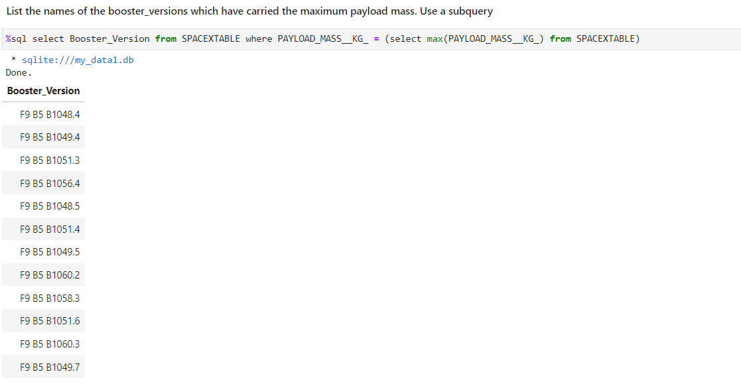
Boosters Carried Maximum Payload
Below is the result of the query to find the names of the booster which have carried the maximum payload mass by finding maximum mass by using subquery. Then matching the subquery result from the database in ‘PAYLOAD_MASS__KG_’ column and use column ‘Booster_Version‘ to show the results.

Slide 48
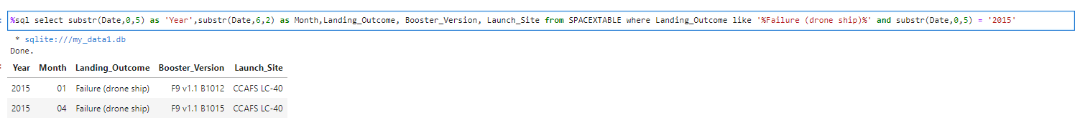
2015 Launch Records
Below is the result of the query to find the failed landing_outcomes in drone ship, their booster versions, and launch site names for in year 2015 by finding the matching string ‘Failure (drone ship)’ in column Landing_Outcome and finding the matching string ‘2015’ in Date column and then for result use column ‘Booster_Version‘, ‘Launch_Site’, ‘Landing_Outcome’ and Date subtring as Year.

Slide 49
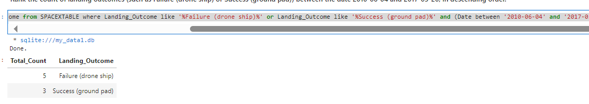
Rank Landing Outcomes Between 2010-06-04 and 2017-03-20
Below is the result of the query to find Rank the count of landing outcomes (such as Failure (drone ship) or Success (ground pad)) between the date 2010-06-04 and 2017-03-20, in descending order by finding the matching string ‘Success (ground pad)' in column Landing_Outcome or ‘Failure (drone ship)' in column Landing_Outcome and finding Date range between the date 2010-06-04 and 2017-03-20 and groupby ‘Landing_Outcome’ and order by the count of it and use ‘desc’ key word for descending. and then use column Landing_Outcome for the results.
Query “%sql select count(Landing_Outcome) as Total_Count, Landing_Outcome from SPACEXTABLE where Landing_Outcome like '%Failure (drone ship)%' or Landing_Outcome like '%Success (ground pad)%' and (Date between '2010-06-04' and '2017-03-20') group by Landing_Outcome order by Total_Count desc”

Slide 50

Section 3

Slide 51
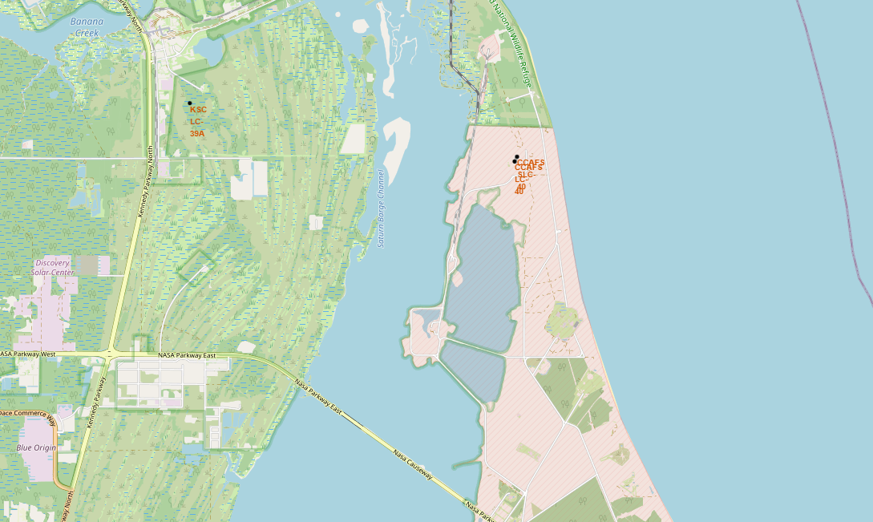
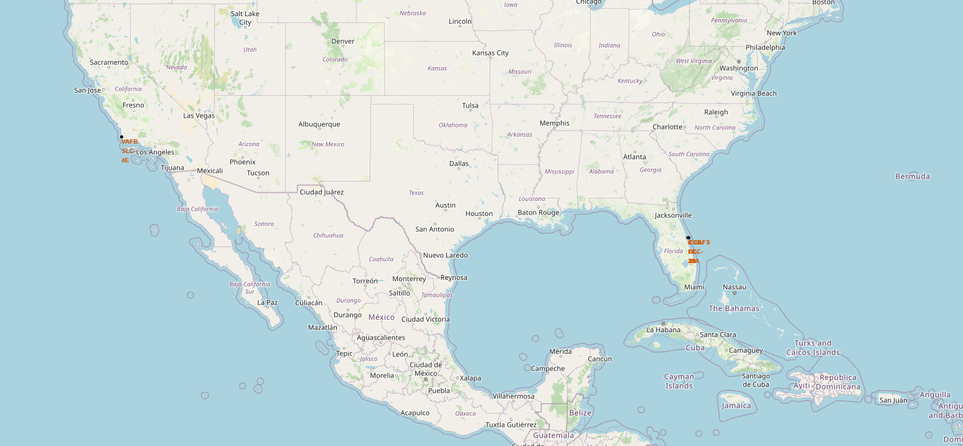
Launch sites Map
All the launch sitea are close to Equator line. And also all the launch stie are very close to the coast line.

Slide 52
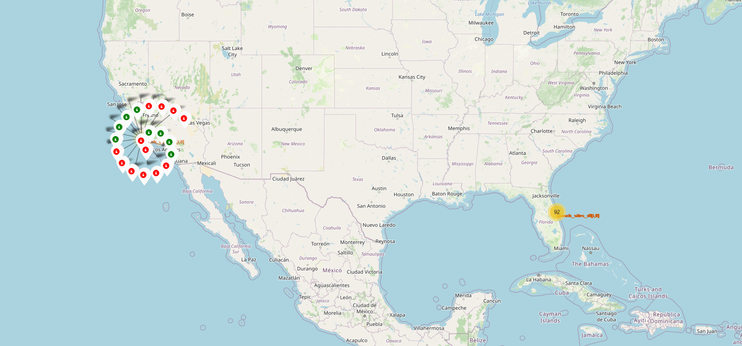
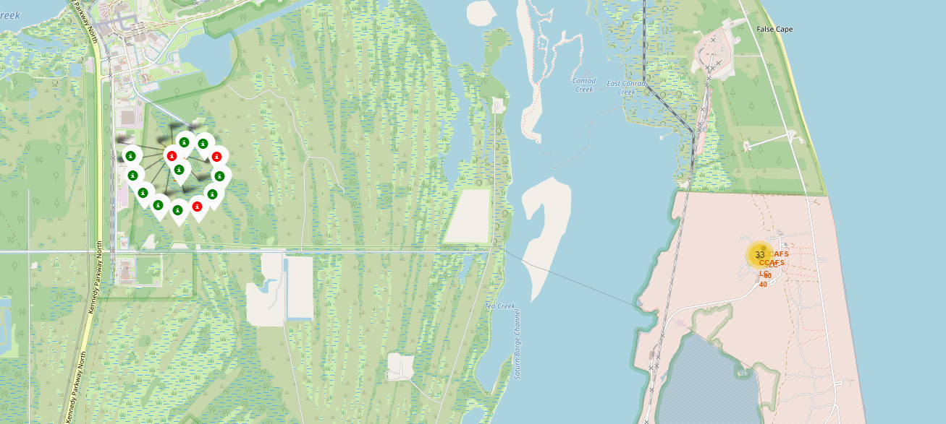
Success/Failed launches for each site on the map:
If a launch was successful (class=1), then we use a green marker and if a launch was failed, we use a red marker (class=0).
We can see the outcomes of each launch site
KSC LC-39A launch site have more successful missions.

Slide 53
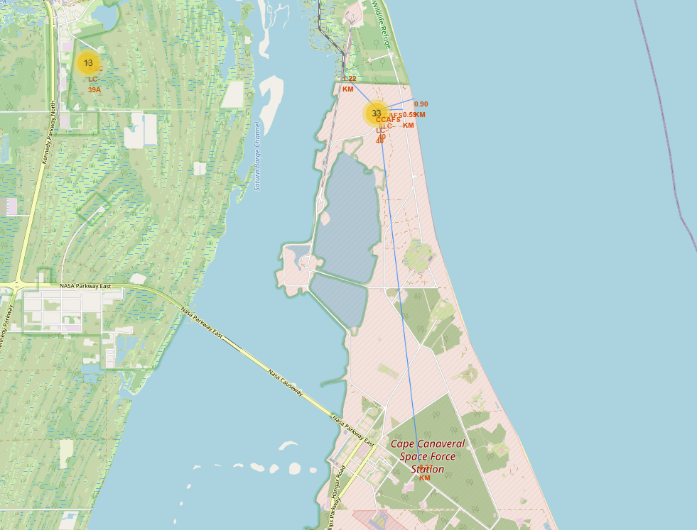
Distances between a launch site to its proximities
Launch sites are in close proximity to railways at around 2 km.
launch sites are in close proximity to highways at around 1 km.
Launch sites are in close proximity to coastline at around 1 km.
Launch sites are far away from cities at around 9 km.

Slide 54

Section 4

Slide 55
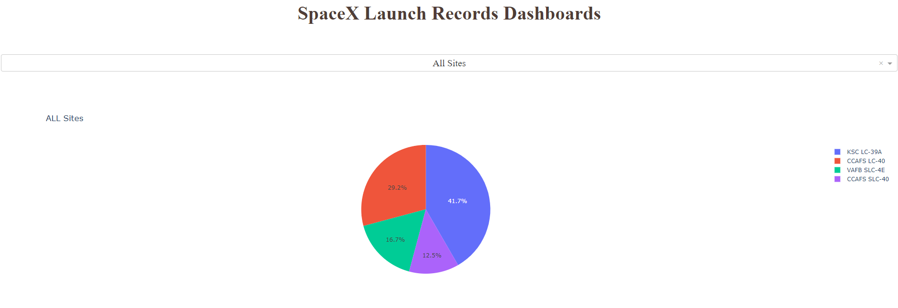
All Launching site Success Rate
'KSC LC-39A’ site have higher success rate while 'CCAFS SLC-40’ site has lower success rate.

Slide 56
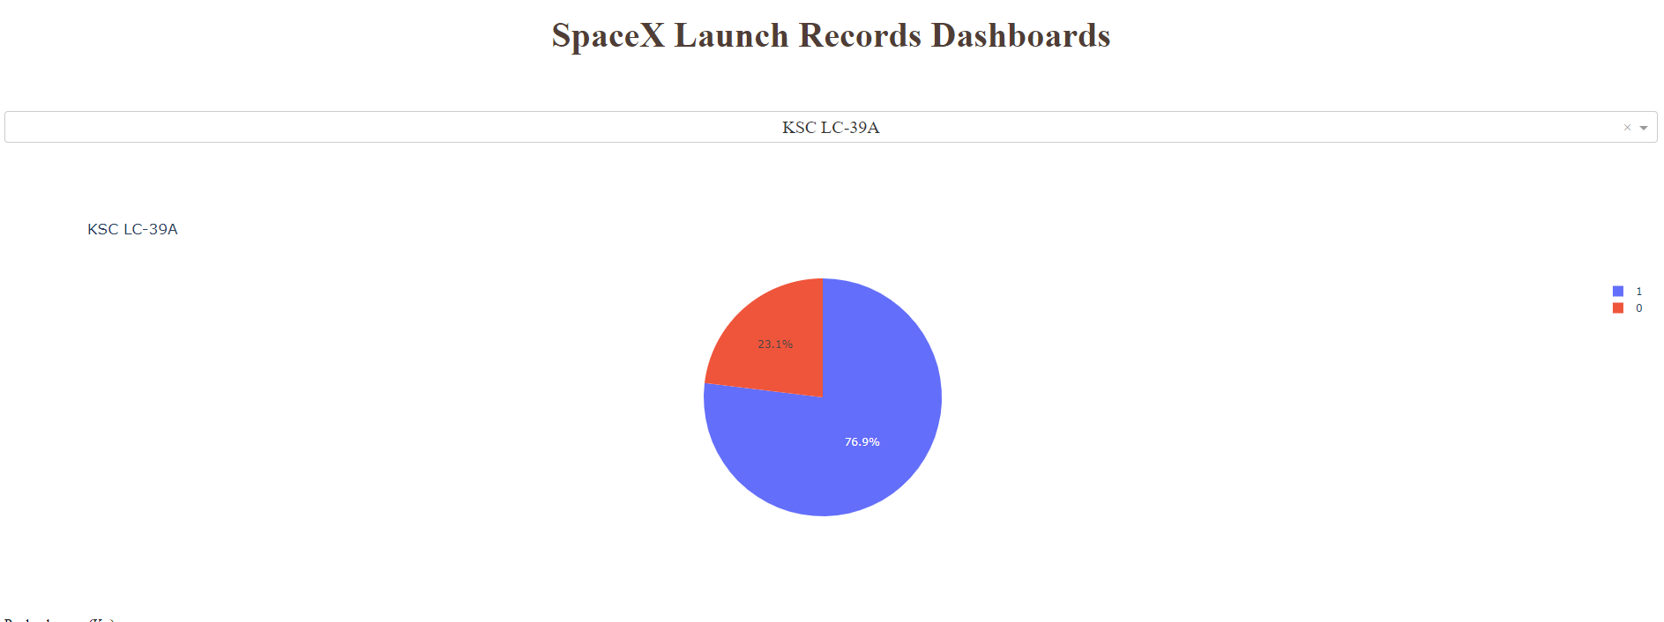
Higher Successful Launch Site
76.9 percent flight mission was successful. While 23.1 percent the flight mission was unsuccessful.

Slide 57
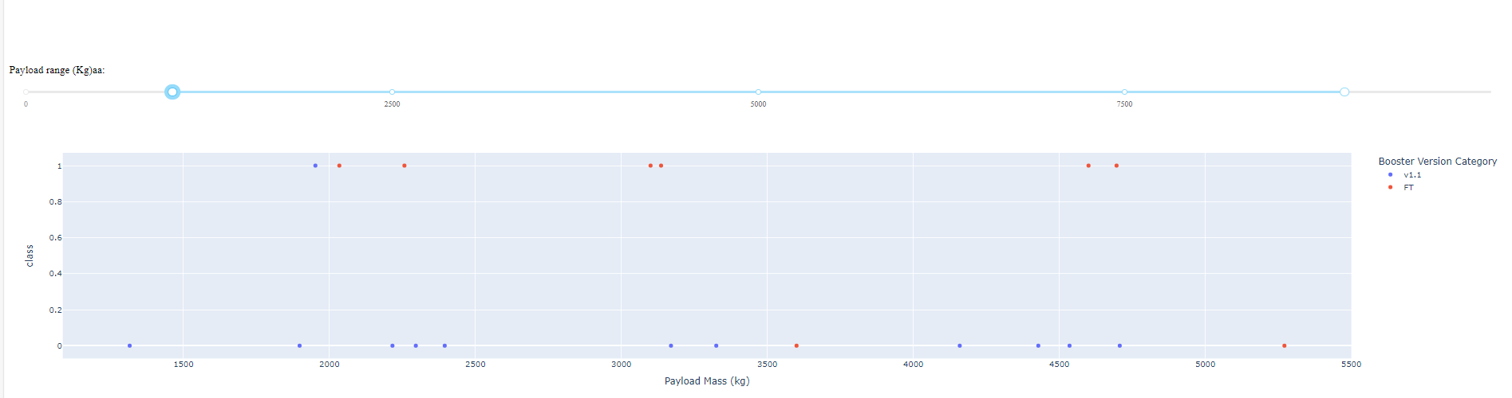
Payload vs. Launch Outcome scatter plot for all sites
'CCAFS LC-40’ site scatter plot shown above. Maximum payload is less than 5500. The booster versions are v1.1 and FT. Booster version FT mostly successful which has payload less than 5000.

Slide 58
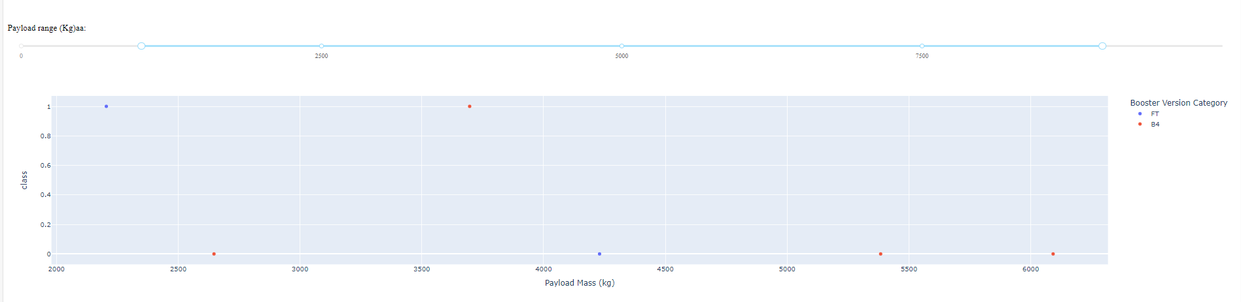
Payload vs. Launch Outcome scatter plot for all sites (Cont..)
'CCAFS SLC-40’ site scatter plot shown above. Maximum payload is less than 6500. The booster versions are B4 and FT. The success rate is not good for both booster.

Slide 59
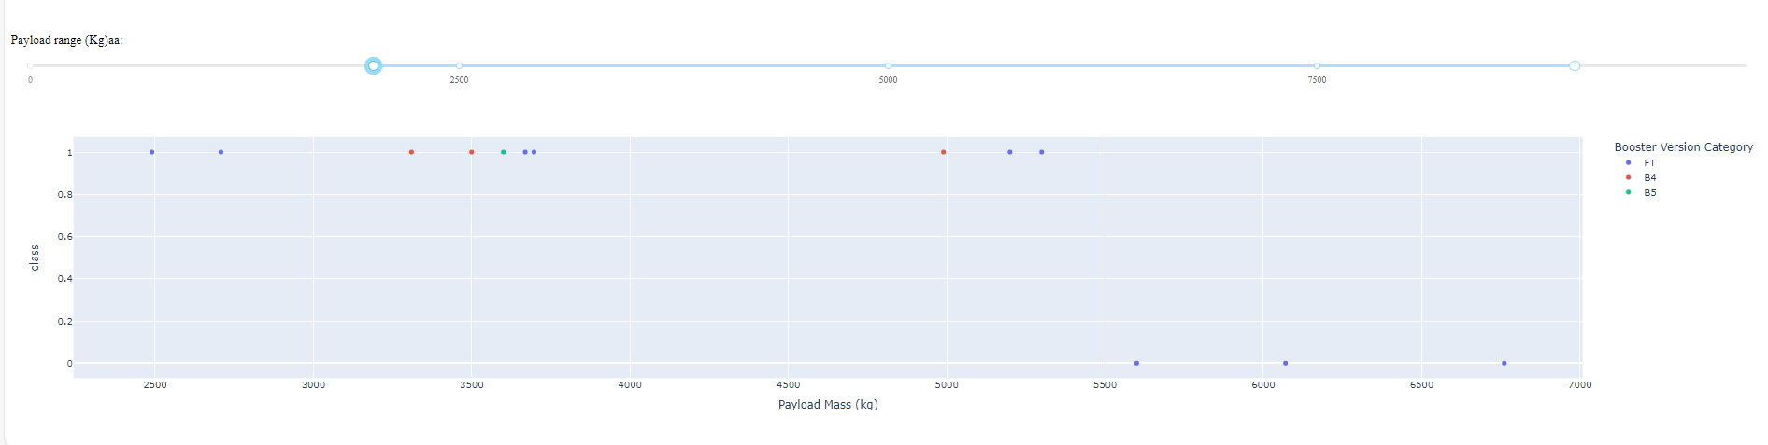
Payload vs. Launch Outcome scatter plot for all sites (Cont..)
'KSC LC-39A’ site scatter plot shown above. Maximum payload is less than 7000. The booster versions are B4, B5 and FT. It is not successful with payload more than 5500. All booster version was successful with payload less than 5500.

Slide 60
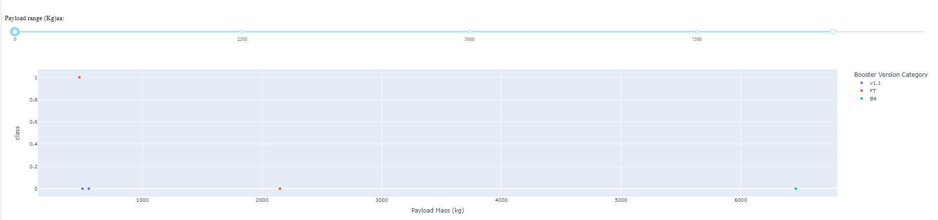
Payload vs. Launch Outcome scatter plot for all sites (Cont..)
'VAFB SLC-4E’ site scatter plot shown above. Maximum payload is less than 10000. The booster versions are B4, v1.1 and FT. It is not successful with payload more than 1000. Only one successful flight with payload more than 9000.

Slide 61
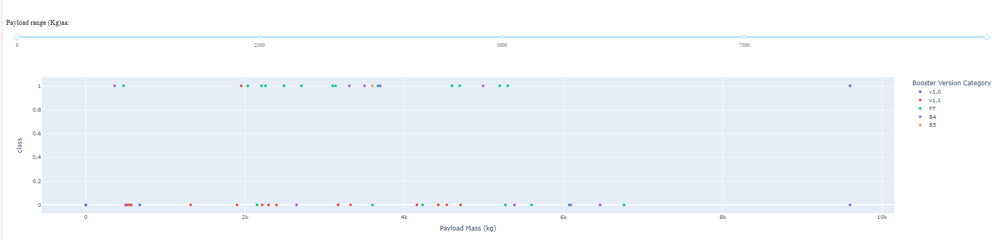
Payload vs. Launch Outcome scatter plot for all sites (Cont..)
All sites scatter plot shown above. The booster versions are B4, v1.1, v1.0, B5 and FT.

Slide 62

Section 5

Slide 63
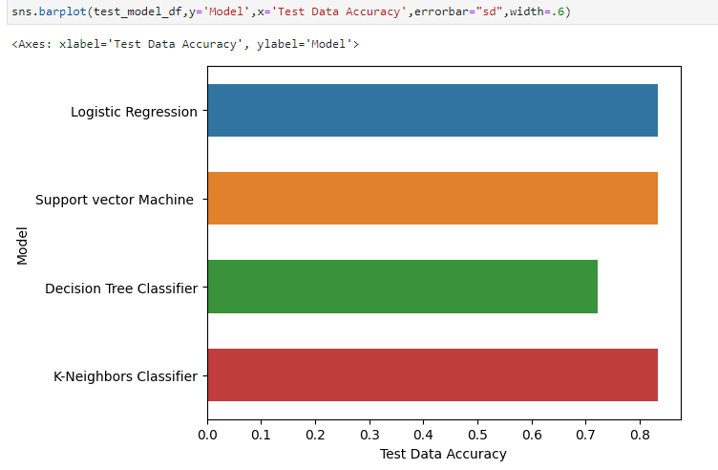
Classification Accuracy
On Test data set Logistic Regression, Support vector machine and K-Neighbors Classifier models have equal higher accuracy score 0.8333.

Slide 64
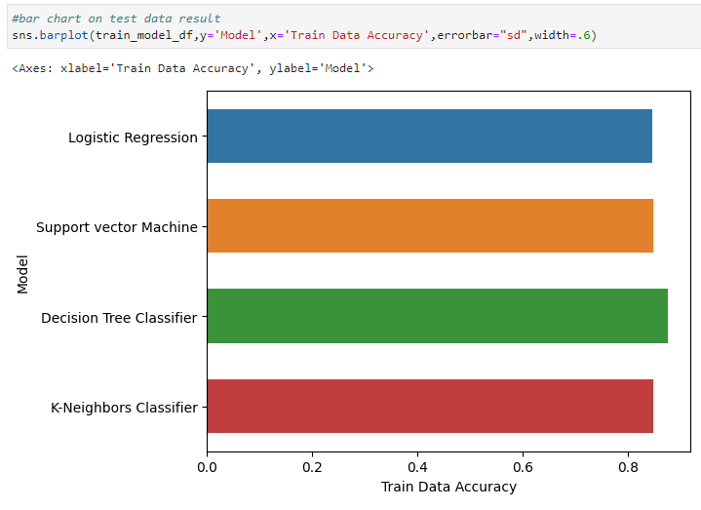
Classification Accuracy (Cont….)
On Train data Decision Tree Classifier has highest accuracy score 0.875.

Slide 65
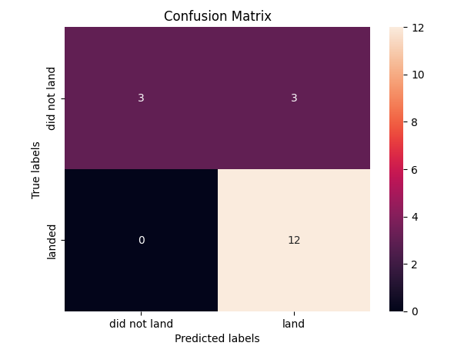
Confusion Matrix
The best performing models on Test data set are Logistic Regression, Support vector machine and K-Neighbors Classifier. All have same confusion matrix as shown on the right side. Equal number of False positive, True Positive and True negative.

Slide 66
Conclusions
On Train data Decision Tree Classifier has highest accuracy score 0.875.
On Test data set Logistic Regression, Support vector machine and K-Neighbors Classifier models have equal higher accuracy score 0.8333.
On Test data Decision Tree Classifier has lowest accuracy score 0.7222.
Logistic Regression, Support vector machine and K-Neighbors Classifier have same confusion matrix. We can use these models to predict the outcome of the spaceship landing.
The main problem here is False positive outcome which may cause wrong cost colculation of the spaceship launch.

Slide 67
Innovative Insite
'KSC LC-39A’ site have higher success.
'KSC LC-39A’ site all booster versions were successful with payload less than 5500.
So, if you want the launch mission to be 100 percent successful, this site 'KSC LC-39A’ must be used.

Slide 68
Appendix
Include any relevant assets like Python code snippets, SQL queries, charts, Notebook outputs, or data sets that you may have created during this project

Slide 69


